Slide 1
Analysis of Russian Texts Using Deep Impostor Method
Students: Daniel Feldman, Arthur Cherniy
Supervisors: Dr. Renata Avros, Prof. Zeev Volkovich.
Notes:
add pov

Slide 2
INSPIRATION
Inspired by the method presented in the paper “Comprehension of the Shakespeare Authorship question through deep impostor approach” presented by Avros Renata and Zeev Volkovich.
Notes:
supervisors recognition

Slide 3
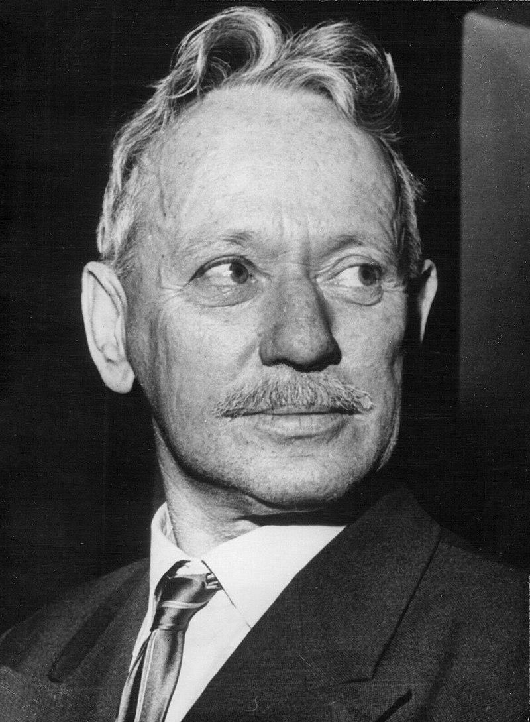

INTRODUCTION
Mikhail Sholokhov
The authorship debate surrounding the book of “And quiet flows the Don” of Mikhail Sholokhov.
And Quiet Flows the Don
Winner of the Stalin Prize, 1941.
Winner of the Nobel Prize in Literature, 1965.
Notes:
controversy

Slide 4
RESEARCH DESCRIPTION
Our method is composed of several machine learning approaches:
BERT
Neural Networks
Isolation Forest
Clustering

Slide 5
IMPOSTORS AND TARGET TEXTS
The process starts with 2 groups of texts
Impostor Texts
Target Texts
Iteration on every pair of impostors.
Notes:
combinations of impostor

Slide 6
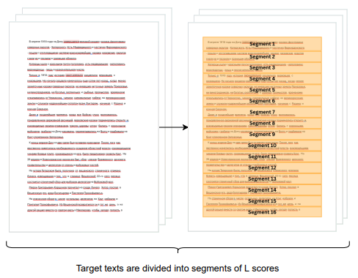
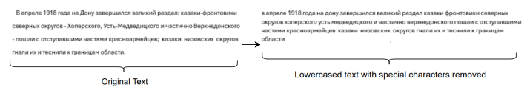
SEGMENTATION AND RUSSIAN TEXT PRE-PROCESSING
Notes:
punctuation

Slide 7
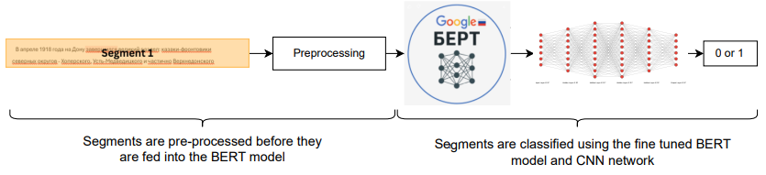
FINE TUNING
The model consists of a pre-trained BERT and a CNN appended to it.
it is trained to distinguish between the impostors selected for the current iteration.
Notes:
instead of modeling Sholokhov directly, we evaluate the test text relatively
over each iteration, we train the model

Slide 8
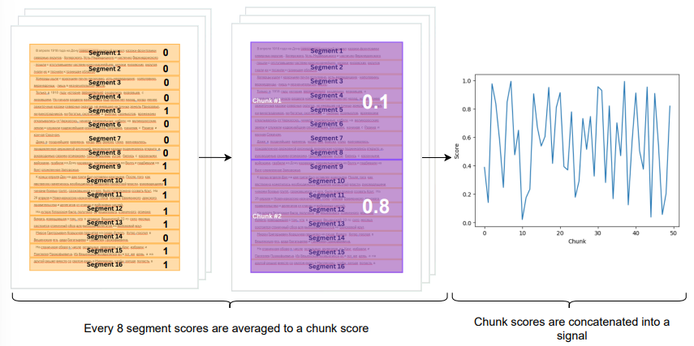
DOCUMENT TO SIGNAL CONVERSION
After the model has been fine tuned, each target text segment is labeled using it
Each k segments are average into a chunk score.
Chunk scores are concatenated to form a signal.
Signals are saved.
Notes:
fingerprint

Slide 9
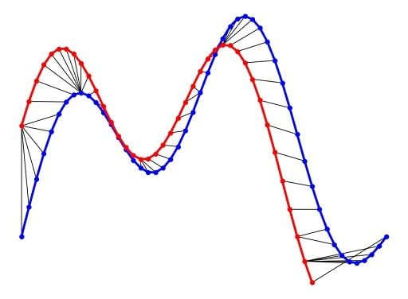
DYNAMIC TIME WARPING DISTANCE
After all target texts are turned to signals, a distance matrix is formed by the calculation of the DTW distance from each signal to all the other signals.

Slide 10
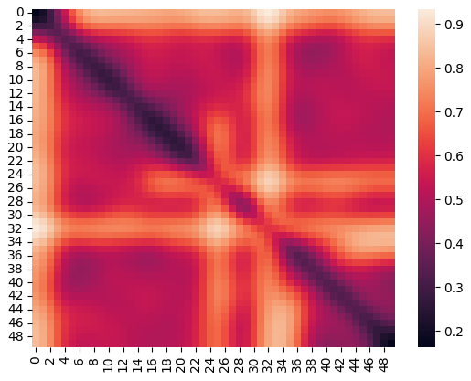
ANOMALY DETECTION
Once all signals had their DTW distances calculated, Isolation Forest algorithm is used to detect anomalies and each signal receives an anomaly score.
Anomaly scores are saved and the next iteration starts until all impostor pairs are done.
By using anomaly scores, signals are labeled as authentic and not authentic

Slide 11
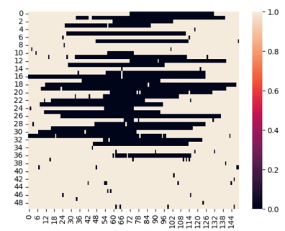
RESULTS
Isolation Forest scores obtained across all impostor pairs are saved for each text.
Results are clustered across all iterations.

Slide 12




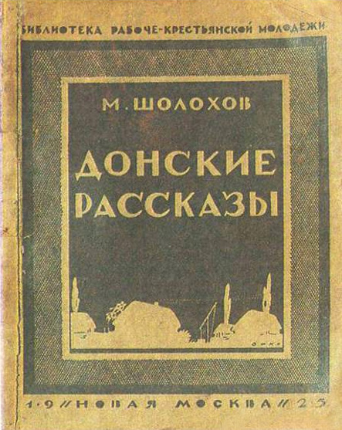

EXPECTED RESULTS
The expectation is that all target works are clustered into 2 groups: Authentic and not authentic.
The smallest group are suggested to be composed from not genuine creations.

Slide 13
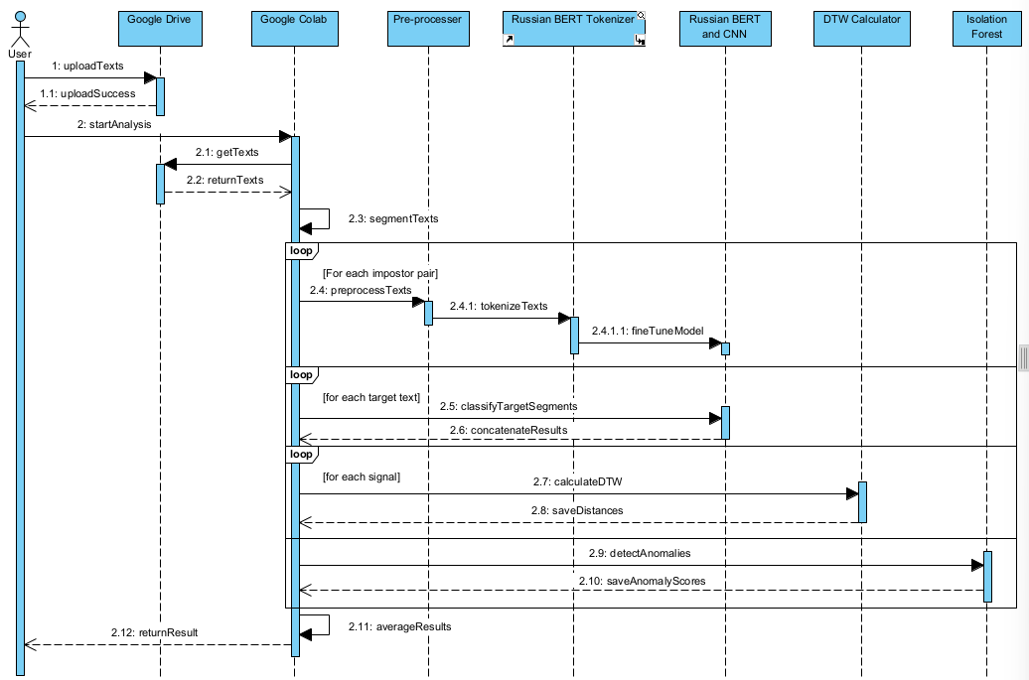
SEQUENCE DIAGRAM

Slide 14
EXPECTED CHALLENGES
Locating the entire corpus of M. Sholokhov.
Extracting Text from files.
Integration of existing Russian BERT tokenizer and model to the project.

Slide 15
TESTING PLAN
Process Test: Well known author whose authorship is not debated.
4 Modules: Pre-Processing, Classification, DTW Calculation and Result Calculation.

Slide 16
TESTING PLAN
# | Test Description | Expected Outcome
1. | Enter Russian text into the preprocessing module. | Module returns the preprocessed Russian text.
2. | Enter Hebrew text into the preprocessing module. | Module throws an exception asking only to enter Russian letters.
3. | Enter an empty string into the preprocessing module. | Module throws an exception asking to enter an input with letters.
4. | Enter an integer into the preprocessing module. | Module throws an exception asking to only enter Russian letters.
5. | Enter preprocessed Russian text into the classification module. | Module returns the token array, attention mask and token IDs.
6. | Enter unprocessed Russian text into the classification module. | Module throws an exception asking only to enter preprocessed Russian text.
7. | Enter an empty string into the classification module. | Module throws an exception asking only to not enter empty strings.

Slide 17
TESTING PLAN
# | Test Description | Expected Outcome
8. | Enter an integer into the classification module. | Module throws an exception asking only to enter preprocessed Russian text.
9. | Enter preprocessed Hebrew text into the classification module. | Module throws an exception asking only to enter preprocessed Russian text.
10. | Enter 2 Impostor different impostor names into the classification module. | Module trains the model to distinguish between the two impostors and returns a positive message.
11. | Enter the same impostor name into the classification module | Module throws an exception asking to use different impostors.
12. | Enter an impostor name whose texts are not in the system into the classification module. | Module throws an exception saying it could not get the impostor texts.
13. | Enter 2 valid signals into the DTW Distance Calculation Module. | Module returns a scalar representing the dtw distance of signal 1 to signal 2.
14. | Enter 1 signal and 1 null into the DTW Distance Calculation Module. | Module throws an exception asking to only enter a pair of 2 signals.

Slide 18
TESTING PLAN
# | Test Description | Expected Outcome
15. | Enter a signal with a coordinate higher than 1 and 1 valid signal into the DTW Distance Calculation Module.. | Module throws an exception mentioning that an entered signal has an invalid score.
16. | Enter 2 strings into the DTW Distance Calculation Module. | Module throws an exception asking to only enter valid signals.
17. | Enter a valid distance matrix into the Anomaly Detection Module. | Anomaly Detection Module returns a valid array of labels.
18. | Enter an empty matrix into the Anomaly Detection Module.. | Module throws an exception asking to only enter a matrix with data.
19. | Enter a string into the Anomaly Detection Module.. | Module throws an exception asking to only enter a valid distance matrix.
20. | Enter a valid label matrix into the Result Calculation Module. | Module returns a valid array of labels.
21. | Enter an empty matrix into the Result Calculation Module. | Module throws an exception asking to only enter a matrix with data.
22. | Enter a string into the Result Calculation Module. | Module throws an exception asking to only enter a valid labeling matrix.

Slide 19
THANK YOU FOR YOUR ATTENTION!

